Slide 1
Java Control Statements | Control Flow in Java

Slide 2
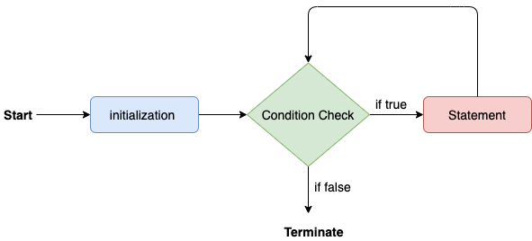
Java for loop

Slide 3
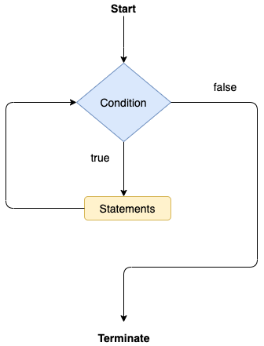
Java while loop

Slide 4
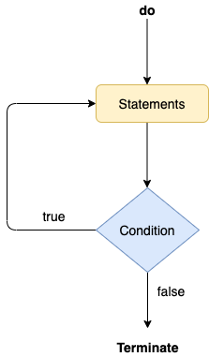
Java do-while loop

Slide 5
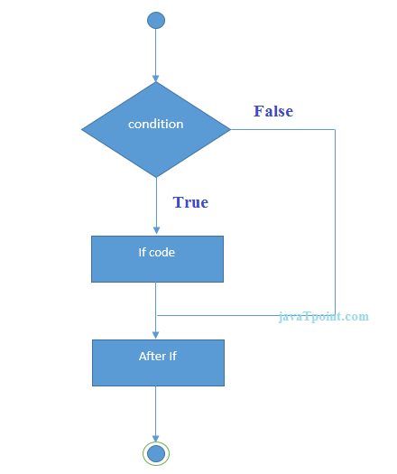
Java if Statement

Slide 6
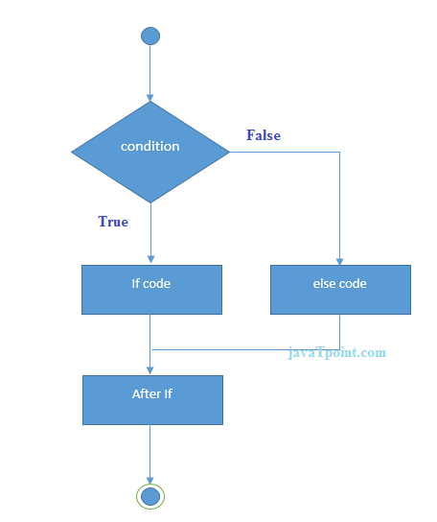
Java if-else Statement

Slide 7
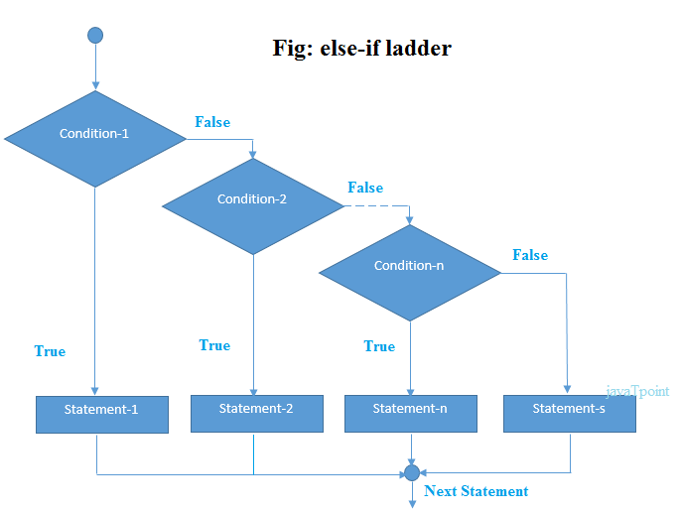
Java if-else-if ladder Statement

Slide 8
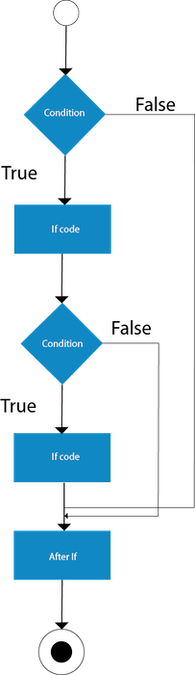
Java Nested if statement

Slide 9
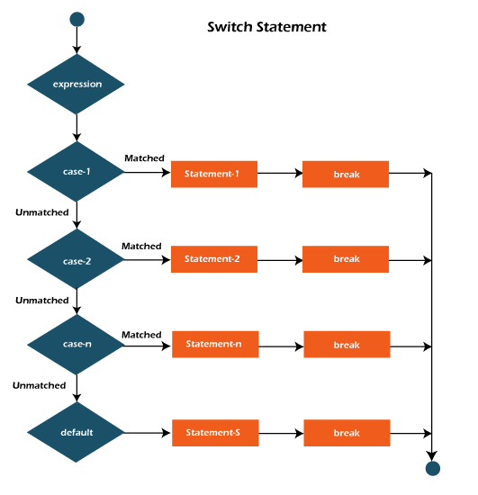
Java Switch Statement

Slide 10
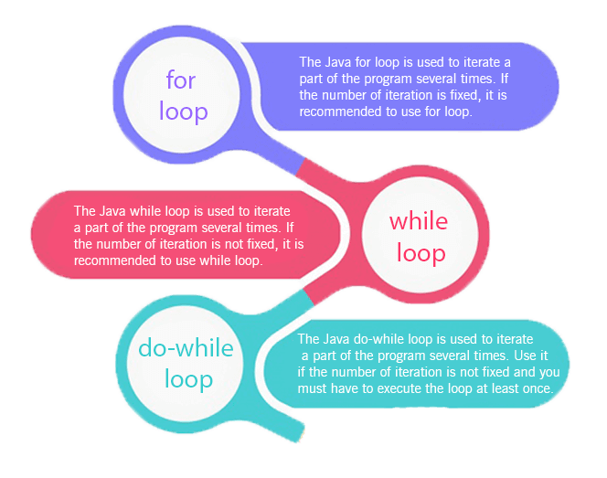
Loops in Java

Slide 11
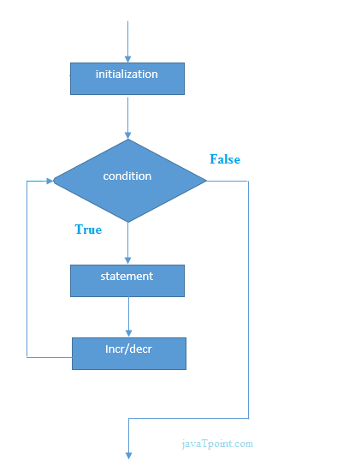
Java Simple for Loop

Slide 12
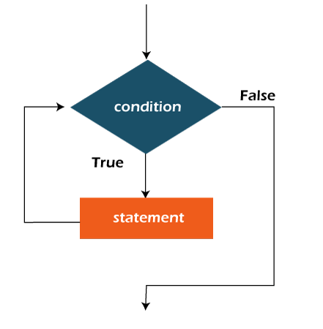
Java While Loop

Slide 13
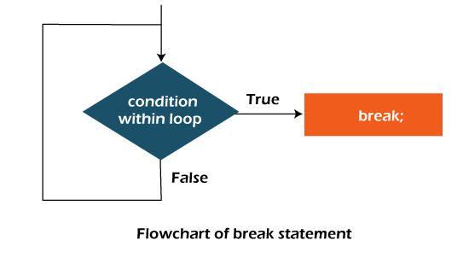
Java Break Statement

